Slide 1
What is Polymer Resin?
Resin is a solid or highly viscous substance of plant or organic synthetic compound which begins a highly viscous state and hardens with treatment.
Polymer resin is a clear liquid plastic product that hardens to create a thick, durable, glossy coating.

Slide 2
Once hardened, it is fade-proof and water-resistant. This type of resin is commonly used on furniture to seal finishes and create a durable, glass-like surface,
and it's also used in many other arts and crafts when the artist wants a thick, glossy coating.
Typically resin is soluble in alcohol not in water.
Polymer resins are often used to give furniture protective, glossy coatings

Slide 3
Types of Resin
Resin can be divided into two types depending on the nature of synthesis. Resin is of two types:
1.Natural Resin
2. Synthetic Resin

Slide 4
1. Natural Resin-
These types of Resin have a natural source. They are obtained from nature. Mostly they originate from the plants. Therefore, known as plant resin.
It can be isolated by the whole plant, specific part, or exudes by plants as a result of injury/incision.
Rarely some natural resin is obtained from the animal.

Slide 5
Examples of plants from which resin can be obtained-:
Benzoin, ginger, podophyllum, asafoetida, and capsicum.
A classic example is pine sap, which has the characteristic sharp odor of terpene compounds. As anyone who has interacted with pine sap knows, the substance is very viscous, but it hardens over time

Slide 6
2. Synthetic Resin-
These types of resin are produced in the industry. Synthetic resins are produced by the curing of the rigid polymer.
When they undergo a curing process, they contain reactive end groups like epoxides or acrylates. It can be of various types:
Thermoplastic resins
Epoxy resins
Casting resins
Epoxy resins
Ion exchange resins

Slide 7
For the most part, polymers made with “resins” are actually made with synthetics, which are cheaper and easier to refine.
Synthetic varieties are much more stable, predictable, and uniform than natural ones as well, since they are made under controlled conditions without the possibility of the introduction of impurities.
They are made by combining chemicals in a laboratory to stimulate a reaction which results in the formulation of a resinous compound. Once formed, the substance can be used in the production of plastics, paints, and many of the same substances that natural resin is used in.

Slide 8
Resin Chemical Nature
What is in resin is the most commonly asked question in the polymer chemistry branch.
The answer to this question is, Resin chemically is a complex compound.
It is formed by a mixture of various compounds. These are a mixture of essential oil. It can be a mixture of oxygenated products of terpenes (oxygenated hydrocarbons) or it can be a complex mixture of hydrocarbons, acid, ester, and alcohol.

Slide 9
Properties of Resins
These are transparent or translucent solid or semisolid in nature.
The specific gravity of resins is more than water. Therefore, these are heavier than water.
They generally become soft on heating. On further heating, resins will be melted.
Resins generally occur in an amorphous state.
These are generally insoluble in water.
These are soluble in organic compounds like alcohol, volatile oils, These compounds are highly enriched with carbon.
Resins generally undergo a slow oxidation process in the atmosphere and become dark in colour.

Slide 10
Classification of Resin
Phenol-formaldehyde resins
Phenol formaldehyde resin (plastic) was the first commercial polymers used in the 20th century.
We abbreviate the Phenol formaldehyde resin as PF. It is also known as the phenolic resin, one of the first synthetic polymers that we can obtain by the reaction of phenol or substituted phenol with formaldehyde.
We produce phenolic resins by a step-growth polymerization reaction that can be either in the presence of acid or base (used as catalysts).

Slide 11
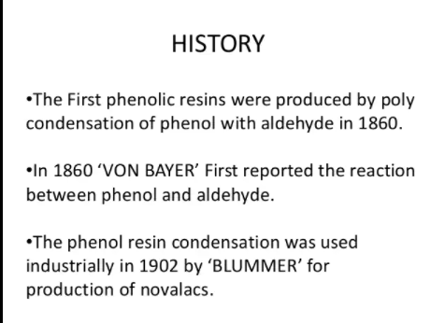

Slide 12
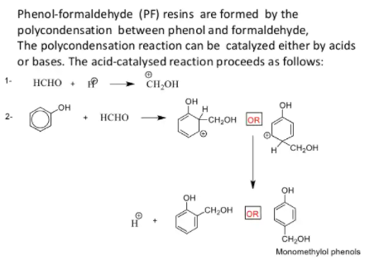

Slide 13
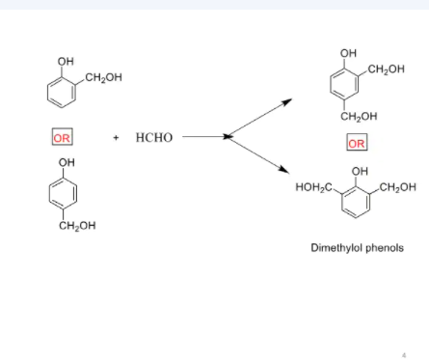

Slide 14
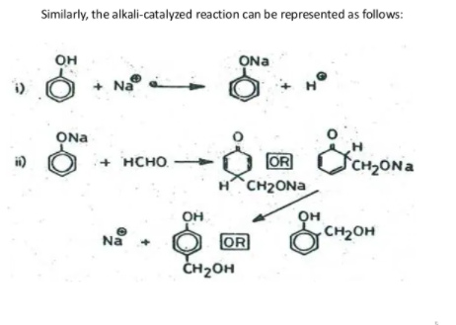

Slide 15
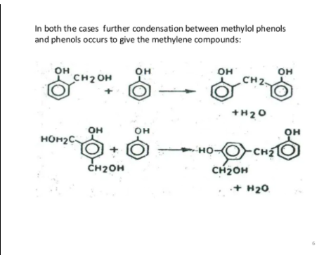

Slide 16
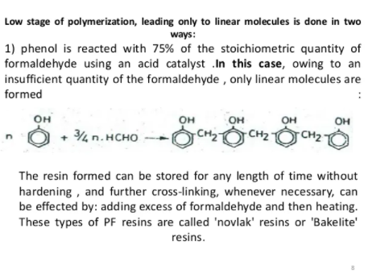

Slide 17
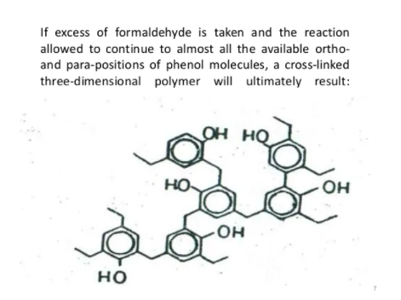

Slide 18
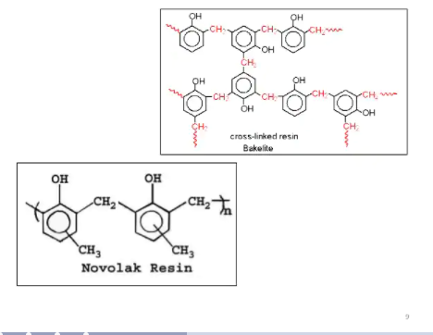

Slide 19
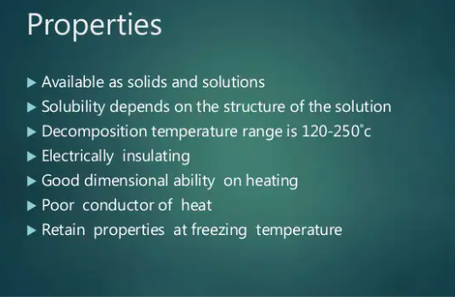

Slide 20
Uses or Application:
Phenol formaldehyde have so many uses in different industry. Phenolic resins are mainly used in the circuit board production that is for making circuit board like PCB ….etc this phenolic resins are used.
In Electrical equipment also it is needed ,caps, handles, buttons, radio cabinets, furniture, knobs, vacuum cleaner, cameras, ash trays, engine ignition equipment.’’
It is also used in Laminated Material like Laminated sheets, rods and tubes are made in great variety from fabric, paper, wood veneers etc impregnated with phenolic, resins providing a range of materials of widely differing properties.

Slide 21
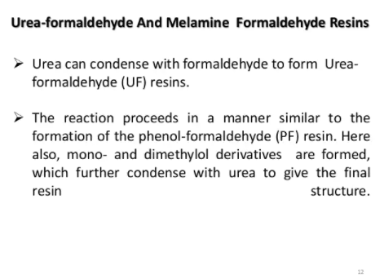

Slide 22
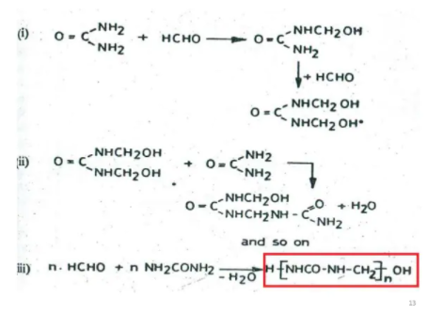

Slide 23
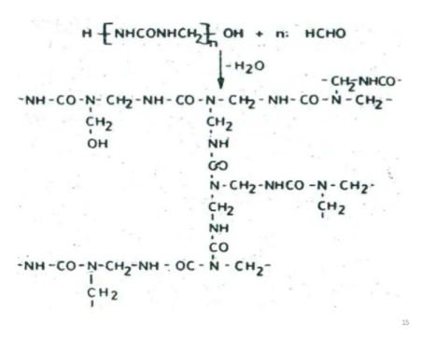

Slide 24
Urea-Formaldehyde Properties
.
High tensile strength – The maximum stress that a material can withstand while being stretched or pulled before breaking.
High flexural modulus – The ratio of stress to strain that a material can endure while bending before it yields.
High heat-distortion temperatures – At what temperature the material will begin to “soften” when exposed to a fixed load at elevated temperatures.
Low water absorption
High surface hardness
Elongation at break – The ratio between changed length and initial length after the material breaks.

Slide 25
Uses
Capital Resin is a melamine and urea formaldehyde resin manufacturer that provides our clients with high-quality resins for multiple applications. As a melamine resin manufacturer, we also offer our services in the following industries.
Air filtration
Packaging Coatings (food, beverage, and industrial)
UF Foam
Decorative laminates
Industrial coatings
Slow release Nitrogen fertilizers
Super plasticizers for concrete

Slide 26
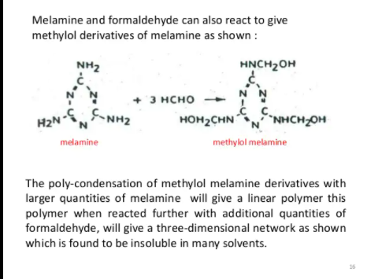

Slide 27
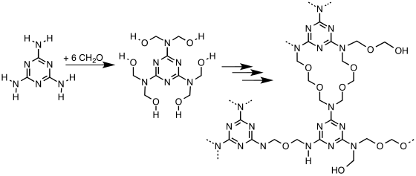

Slide 28
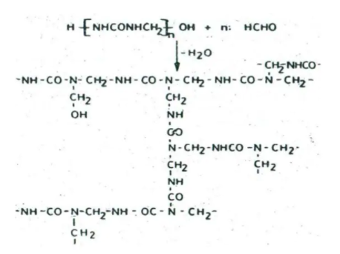

Slide 29
MELAMINE-FORMALDEHYDE RESINS
PROPERTIES
Melamine formaldehyde (also called melamine or MF) is a hard, very durable, and versatile thermosetting aminoplast with good fire and heat resistance.
It is made from melamine and formaldehyde by condensation of the two monomers. Its good fire retardant properties are due to the release of nitrogen gas when burned or charred.

Slide 30
MF resins are quite similar to urea-formaldehyde (UF) resins and are fully compatible with them and, therefore, are often co-reacted with them to reduce formaldehyde emissions from particleboards and to prevent degradation of glue bonds caused by hydrolytic degradation of the UF polymers.
The resin blend is called melamine–urea–formaldehyde (MUF). Compared to natural woods or wood veneers, melamine composite boards and overlay materials have improved heat, moisture, scratch, and chemicals resistance.

Slide 31
APPLICATIONS
Melamine resins are used for the manufacture of many products, including kitchenware, laminates, overlay materials, particleboards, and floor tiles. Melamine and its salts are also used as fire-retardant additives in paints, plastics, and paper.
Melamine foam is a special form of melamine resin. It finds uses as an insulating and soundproofing material and more recently as a cleaning abrasive. The foam products can be used for removing scuffs and dirt from a wide range of surfaces.
Furthermore, some filters are made out of porous melamine. These filters can be used in hot environments, and are extremely efficient.

Slide 32
Melamine is or has been used in the manufacture of flame-resistant fibers and textiles.
These include upholstery, firemen uniforms, thermal liners, and heat resistant gloves and aprons.
Sulfonated melamine formaldehyde (SMF) is used as a super-plasticizer for making high-resistance concrete. It is mainly added to reduce the water content in concrete while increasing the fluidity and the workability of it during handling and pouring. The result is a concrete with a lower porosity and a higher mechanical strength, which exhibits an improved resistance to aggressive environments and has, therefore, a longer lifetime.

Slide 33
Epoxy resins;
Epoxy resins are typically formed by the reaction of compounds containing at least two active hydrogen atoms (polyphenolic compounds, diamines, amino phenols, heterocyclic imides and amides, aliphatic diols,etc.) and epichlorohydrin.

Slide 34
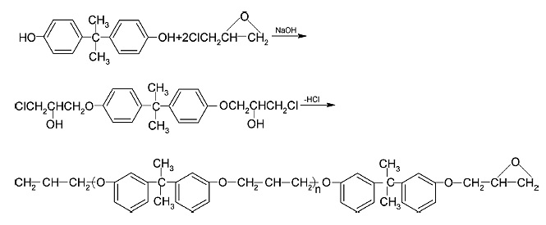
Synthesis of Epoxy resin from Bisphenol A and
Epichlorohydrin

Slide 35
Key Properties of Epoxy Resins
High strength
Excellent adhesion to various substrates
Effective electrical insulation
Chemical and solvent resistance, and
Low cost and low toxicity

Slide 36
Epoxies are easily cured, and they are also compatible with most substrates.
They tend to wet surfaces easily, making them especially suitable for composite applications.
Epoxy resin is also used to modify several polymers such as polyurethane or unsaturated polyesters to enhance their physical and chemical attributes.

Slide 37
For thermosetting epoxies:
The tensile strength ranges from 90 to 120 MPa
A tensile modulus ranging from 3100 to 3800 MPa
Glass transition temperatures (Tg) that range from 150 to 220 °C
Beside from the properties mentioned above, epoxy resins have two main drawbacks which are their brittleness and moisture sensitivity.

Slide 38
Polyester resins
Polyester resins are generally thermoplastic polymers which means that they may be formed with heat and re-melted without losing their intrinsic characteristics.

Slide 39
Properties
Polyester resins are transparent, high-density polymers with excellent strength and water resistance with high usage in textiles (where it is known under the tradename “Polyester”) and packaging (where it generally referred to as “PET”).
Compared with other polymers, PET is moderately expensive, shatter-resistant, food resistant, and withstands repeated recycling.

Slide 40
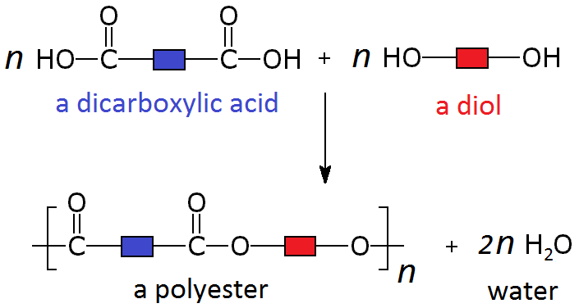

Slide 41
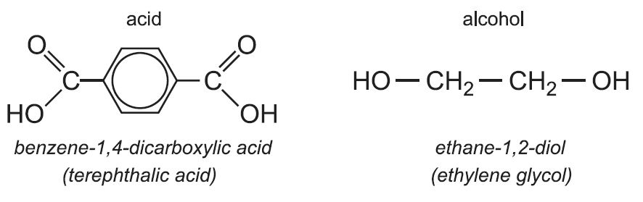

Slide 42
Characteristics of polyester
Polyester fabrics and fibers are extremely strong.
Polyester is very durable: resistant to most chemicals, stretching and shrinking, wrinkle resistant, mildew and abrasion resistant.
Polyester is hydrophobic in nature and quick drying. It can be used for insulation by manufacturing hollow fibers.
Polyester retains its shape and hence is good for making outdoor clothing for harsh climates.
It is easily washed and dried.

Slide 43
Polyester resin has the following disadvantages:
Strong styrene odour
More difficult to mix than other resins, such as a two-part epoxy
The toxic nature of its fumes, and especially of its catalyst, MEKP, pose a safety risk if proper protection isn't used
Not appropriate for bonding many substrates
The finished cure is most likely weaker than an equal amount
of an epoxy resin

Slide 44
Polyamides are prepared by polycondensation between dicarboxylic acids and diamines

Slide 45
Polyethylene
Polyethylenes usually have a linear structure and are known to be addition polymers.
The primary application of these synthetic polymers is in packaging. Polyethelyne is often used to make plastic bags, bottles, plastic films, containers, and geomembranes. It can be noted that over 100 million tonnes of polyethene is produced on an annual basis for commercial and industrial purposes.

Slide 46
The general formula of polyethylene can be written as (C₂H₄)_{n}.
Most types of polyethylene are thermoplastic (they can be remoulded by heating).
However, some modified polyethylene plastics exhibit thermosetting properties.
An example of such a class of polyethylene is cross-linked polyethylene

Slide 47
LDPE is low density poly ethylene.
It is formed by heating ethene at 2000 to 300°C under oxygen as a catalyst.
This reaction follows free radical mechanism. The peroxide formed from oxygen acts as a free radical initiator.
2. LDPE is used as insulation for cables, making

Slide 48
Properties of LDPE?
It is a homopolymer; made of a single monomer, ethylene.
The polymer density is controlled by the kind of branching it has.
LDPE contains a mix of long branched chains and short branched chains.
It is produced by undergoing a high-pressure process.
LDPE is characterized by 50-65% crystallinity, as the packing of the molecules is not the tightest.
It is translucent in appearance, as a result of the crystallinity. However, very thin foils can be transparent.
It is not very easy to bond.
LDPE is sufficiently malleable and elastic, able to undergo significant elongation before breakage.
It is fairly puncture-resistant, between -40 C to 90 C.
LDPE is susceptible to stress-cracking beyond a point.
It has a sufficient moisture barrier.

Slide 49
PVC
PVC stands for polyvinyl chloride, which is a kind of synthetic resin. The phrase synthetic resin is sometimes used to refer to what is commonly called ''plastic''.
Specifically, PVC is a kind of thermoplastic resin, which is a type of resin that can be softened by heating.
In this case, the term ''plastic'' in thermoplastic doesn't refer to a synthetic resin as before but rather to the fact that one feature of PVC is its plasticity, or malleability, in the face of heat.

Slide 50
Uses
Vinyl is versatile : it can be as rigid as industrial pipes, as pliable as plastic wrap, and as thin and flexible as wallcovering. It can also be completely clear or matched to any color desired.

